Slide 1
Identification of Key r-Process Isotopes in Kilonova Heating
Kelsey Lund
North Carolina State University
FIRE Collaboration Meeting
1 July 2020

Slide 2
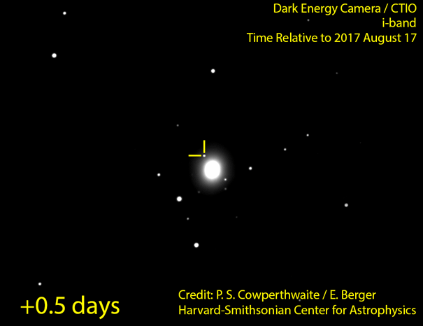
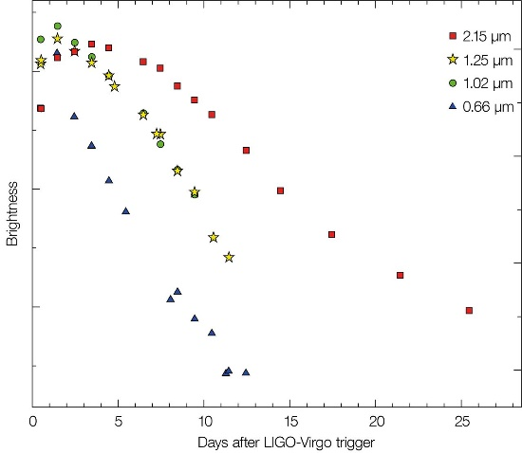
Background: Kilonovae
Observations of GW170817 and accompanying electromagnetic transient suggest neutron star mergers as an important r-process production site.
Radioactive decay of heavy isotopes deposits energy into explosive transient.
A more complicated picture:
How much: Differences in ejecta mechanisms as well as more complicated processes → different yields
What: Robustness of r-process not well constrained → different ejecta composition
How can we infer information from the observed signal?
Tanvir et al 2017
1

Slide 3
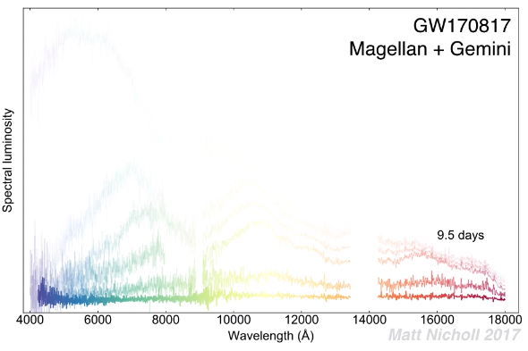
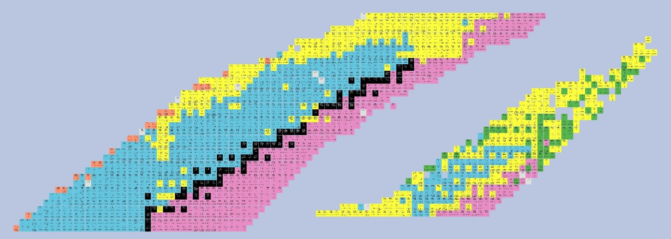
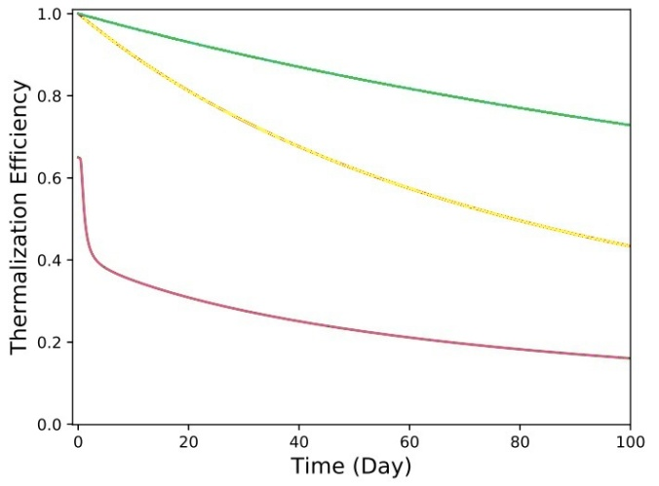
Background: Ejecta Composition
Observation points to relevance of multi-component models:
“Blue” component → free of high-opacity lanthanides
(Evans+ 2017, Miller+ 2019)
“Red” component → high-opacity lanthanides and/or actinides (Evans+ 2017)
Spontaneous Fission
α-decay
β-decay
Zhu+ (submitted)
2

Slide 4
Theoretical Challenges
How much of and what gets made can lead to differences in KN light curves.
During simulation: Evolution of material far from stability, lack of experimental information, sensitivity to astrophysical and nuclear physics inputs.
After simulation: Use data to calculate total and fractional heating from radioactive decays on timescales of days.
3

Slide 5
Methods: Astrophysical Conditions
Accretion disk winds:
Initial entropy s/k=40
Initial temperature 10 GK
Initial seed abundance determined by SFHo EOS
Initial electron fraction (Y_{e}): Proxy for changing astrophysical conditions
{0.02, 0.12, 0.14, 0.16, 0.18, 0.21, 0.24, 0.28}
4

Slide 6
Methods: Nuclear Inputs
Mass Model* & Fission Barrier Height (x8)
Fission Rate (x2) (Karpov+ 2012; Xu&Ren 2005)
Fission Yield (x2) (Symmetric; Kodama&Takahashi 1975)
SLY4 Chabanat+ (1998) (FRLDM)
UNEDF1 Kortelainen+ (2012) (FRLDM)
DZ33 Duflo & Zuker (1995) (FRLDM)
ETFSI Aboussir+ (1995), Mamdouh+ (1998) (ETFSI)
FRDM2012 Möller+ (2016) (FRLDM)
HFB22,27 Goriely+ (2010,2013) (HFB)
WS3V6 Liu+ (2011) (FRLDM)
5

Slide 7
Methods: Nuclear Inputs
Mass Model* & Fission Barrier Height (x8)
Fission Rate (x2) (Karpov+ 2012; Xu&Ren 2005)
Fission Yield (x2) (Symmetric; Kodama&Takahashi 1975)
SLY4 Chabanat+ (1998) (FRLDM)
UNEDF1 Kortelainen+ (2012) (FRLDM)
DZ33 Duflo & Zuker (1995) (FRLDM)
ETFSI Aboussir+ (1995), Mamdouh+ (1998) (ETFSI)
FRDM2012 Möller+ (2016) (FRLDM)
HFB22,27 Goriely+ (2010,2013) (HFB)
WS3V6 Liu+ (2011) (FRLDM)
Experimental data is used wherever possible**
**Wang+ (2017), Audi+ (2017)
5

Slide 8
Methods: PRISM
We want to be able to accurately and reliably model nucleosynthesis in neutron star merger environments
Initial Astrophysical
Conditions
+
Nuclear Inputs
Abundance File
Effective
Heating
Flow File
Nuclear Inputs: Q-value
Thermalization Efficiency
Sprouse+ (2020)
6

Slide 9
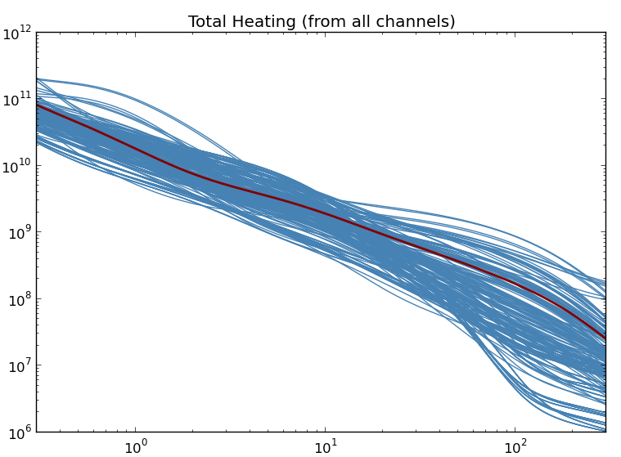
Analysis: Total Heating
Total heating (all reaction & decay channels)
Main contributors:
- Sp. Fission
- α-decay
- β-decay
Heating Rate (erg/s)
(Heating ∝ Flow · Q-value)
Time (d)
7

Slide 10
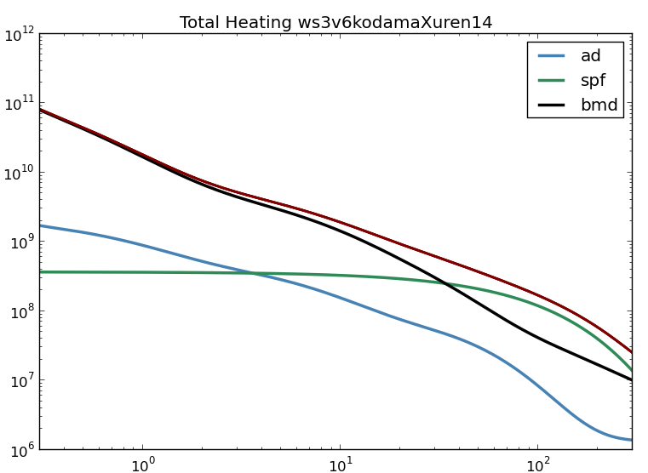
Analysis: β-decay Approximation
Sometimes fits!
Total heating (all reaction & decay channels)
Heating Rate (erg/s)
Time (d)
7

Slide 11
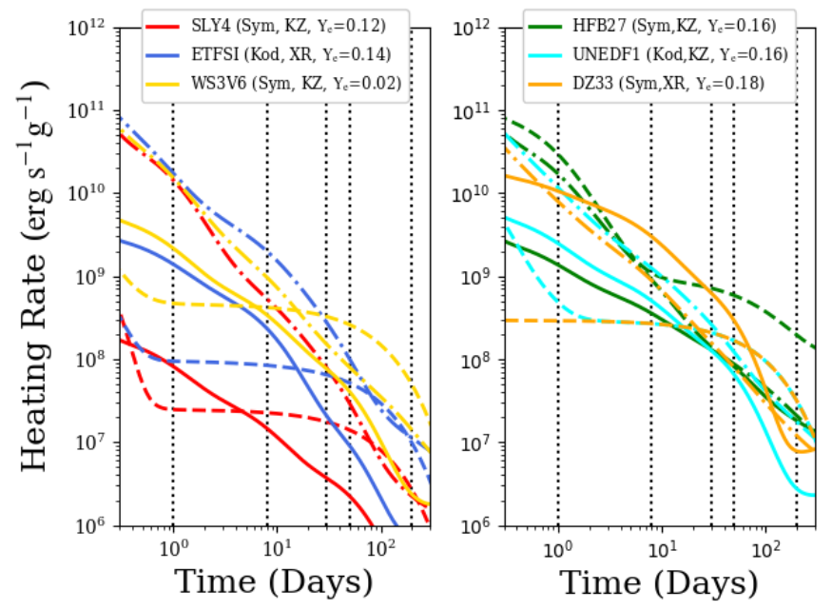
Analysis: Heating by Reaction Channel
By sampling from the range of simulations, we can identify key times to investigate more closely (dashed vertical lines):
1, 8, 30, 50 days
Sp. Fission α-decay β-decay
8

Slide 12
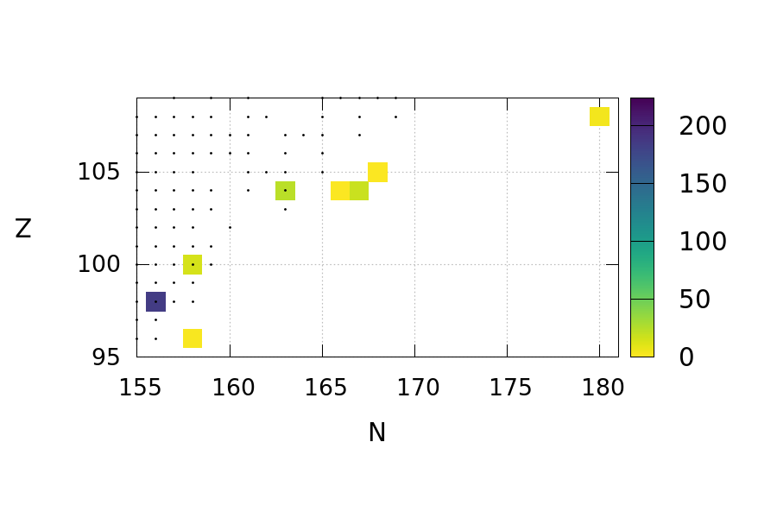
Results: Spontaneous Fission (i)
Frequency of Top (80%) Contributors to Spontaneous Fission Heating : 1 Day
²⁵⁴Cf (see Zhu+ (2018))
Z
N
· indicates evaluated data
9

Slide 13
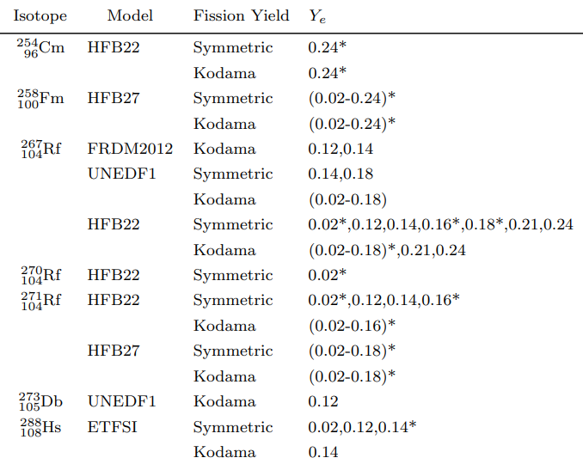
Results: Spontaneous Fission (i)
Frequency of Top (80%) Contributors to Spontaneous Fission Heating : 1 Day
Z
N
· indicates evaluated data
* indicates ²⁵⁴Cf not in top 80%
9

Slide 14
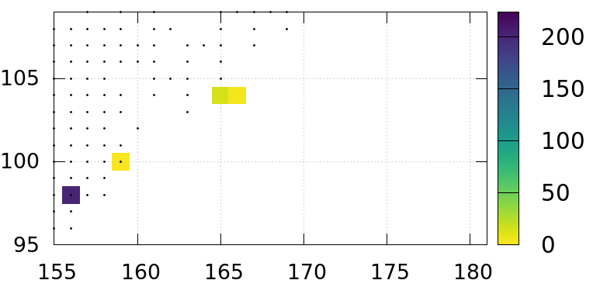
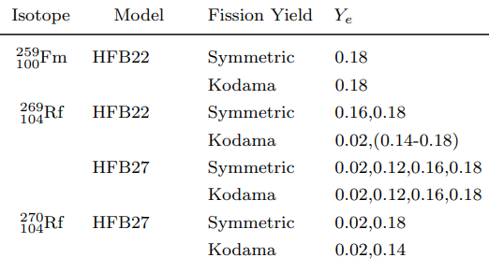
Results: Spontaneous Fission (ii)
Frequency of Top (80%) Contributors to Spontaneous Fission Heating : 8 Days
Z
N
· indicates evaluated data
10

Slide 15
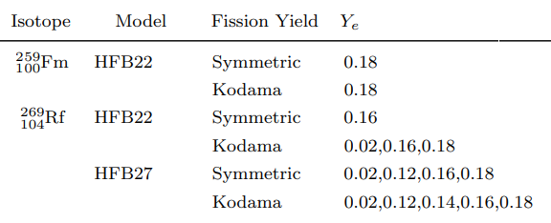
Results: Spontaneous Fission (iii)
Frequency of Top (80%) Contributors to Spontaneous Fission Heating : 50 Days
Z
N
· indicates evaluated data
11

Slide 16
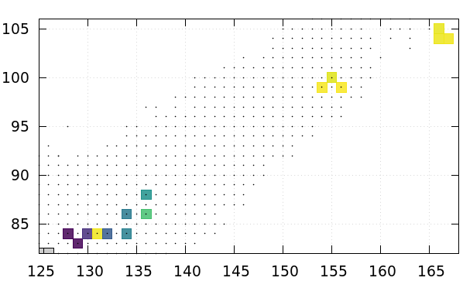
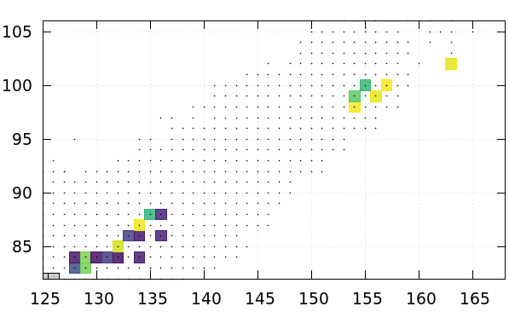
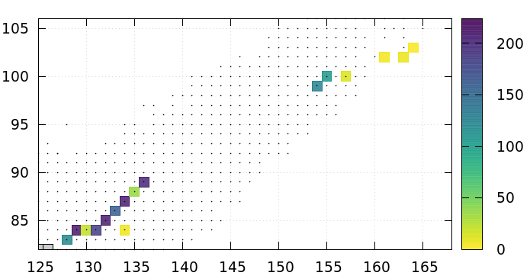
Results: α-Decay
Frequency of Top (80%) Contributors to α-decay Heating
1 Day
8 Days
30 Days
Z
N
· indicates evaluated data
12

Slide 17
Results: α-Decay
Frequency of Top (80%) Contributors to α-decay Heating
1 Day
8 Days
30 Days
Z
N
· indicates evaluated data
12

Slide 18
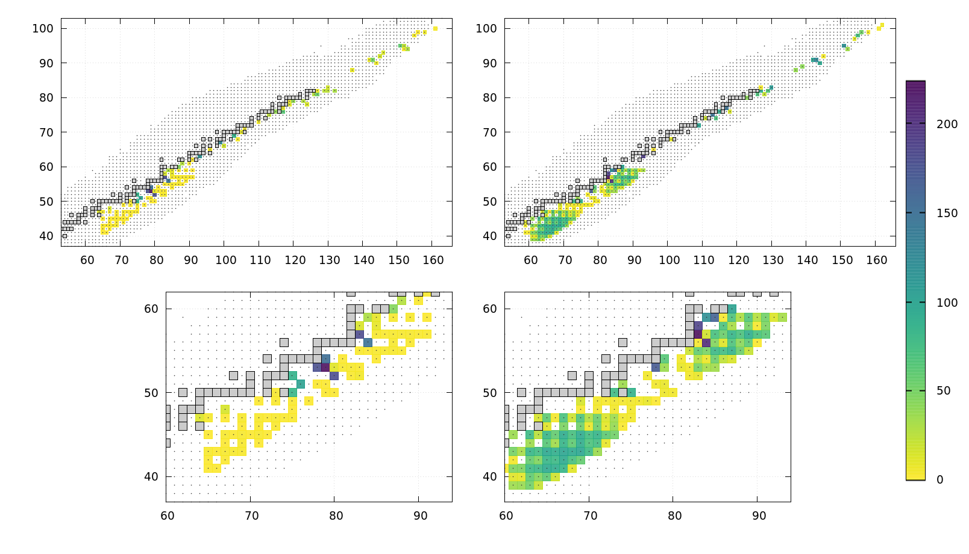
Results: β-Decay
Frequency of Top (80%) Contributors to β-decay Heating
Differences in model predictions show up in diversity of β-decay heaters
8 Days
30 Days
Z
N
· indicates evaluated data
13

Slide 19
Conclusions (i)
- Changes in theoretical nuclear model, fission rate, fission yield, and Y_{e} lead to large changes in expected heating from spontaneous fission & α-decay.
Sp. Fission α-decay β-decay
14

Slide 20
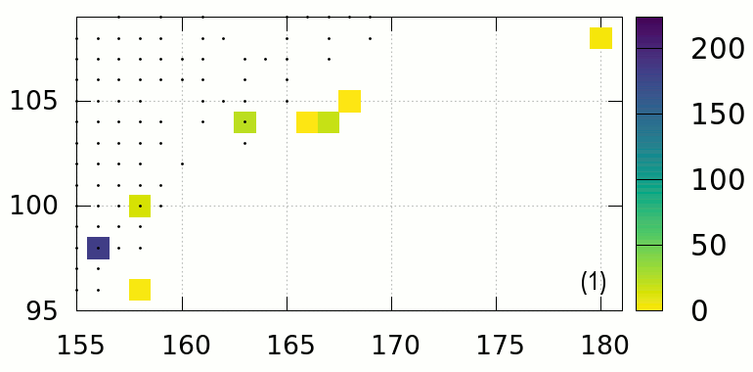
Conclusions (ii)
Changes in theoretical nuclear model, fission rate, fission yield, and Y_{e} lead to large changes in expected heating from spontaneous fission & α-decay.
These differences are reflected in diversity of important spontaneous fission heaters at “early” times. Sensitive to fission barrier height (HFB).
Important Spontaneous Fission Heaters
Z
N
(unmeasured)
15

Slide 21
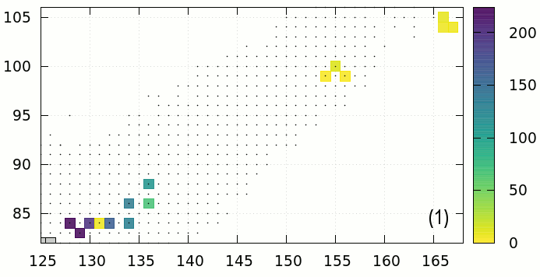
Conclusions (iii)
Important α-decay Heaters
Changes in theoretical nuclear model, fission rate, fission yield, and Y_{e} lead to large changes in expected heating from spontaneous fission & α-decay.
These differences are reflected in diversity of important spontaneous fission heaters at “early” times. Sensitive to fission barrier height (HFB).
Potentially important contribution from α-decay heaters, competition with spontaneous fission (high Z).
Z
N
(unmeasured)
16

Slide 22
Conclusions (iv)
Spontaneous Fission
Changes in theoretical nuclear model, fission rate, fission yield, and Y_{e} lead to large changes in expected heating from spontaneous fission & α-decay.
These differences are reflected in diversity of important spontaneous fission heaters at “early” times. Sensitive to fission barrier height (HFB).
Potentially important contribution from α-decay heaters, competition with spontaneous fission (high Z).
These affect the amount and variety of material that eventually undergoes β-decay
α-Decay
17

Slide 23
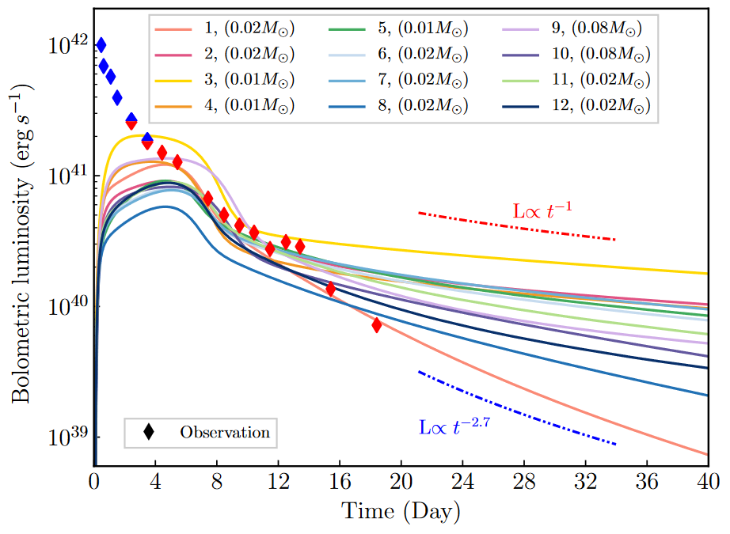
Note: Inferred Mass
Ejecta mass is necessary component for light curve calculation
~ 1 order of magnitude difference in ejected (r-process) mass
Zhu+ (submitted)
18

Slide 24
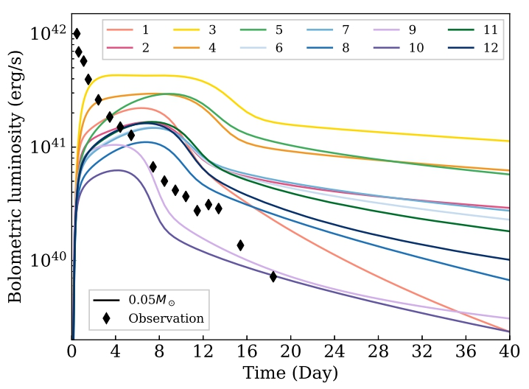
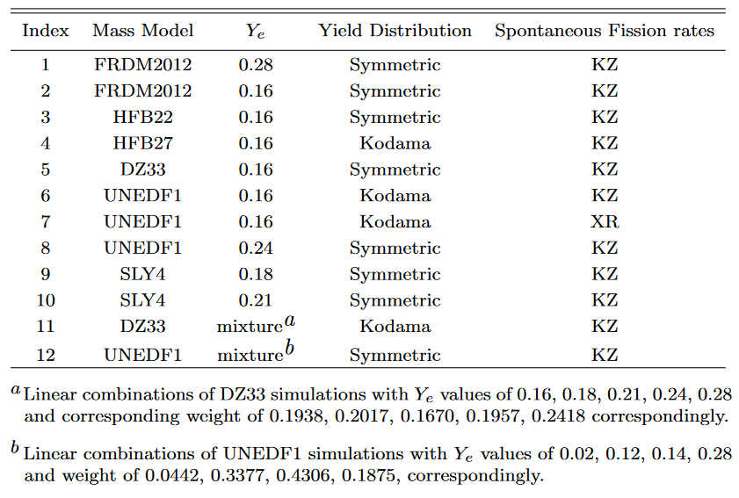
Some Questions
How sensitive is the nucleosynthesis to astrophysical and nuclear inputs?
Could different predictions actually be observable? → Maybe
What measurements are necessary?
Varying the nuclear physics and Y_{e} can change the shape and magnitude of the light curve!
Zhu+ (submitted)
19

Slide 25
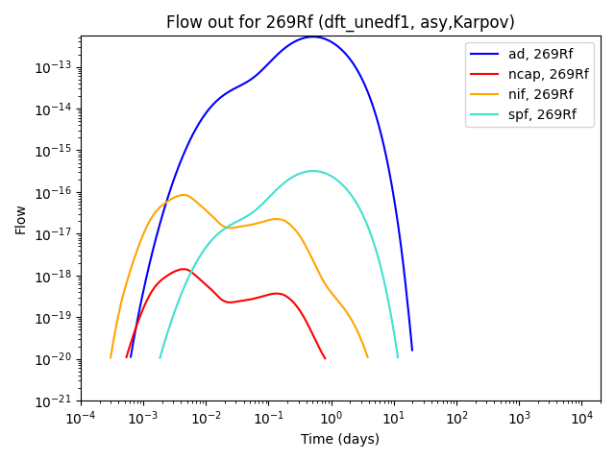
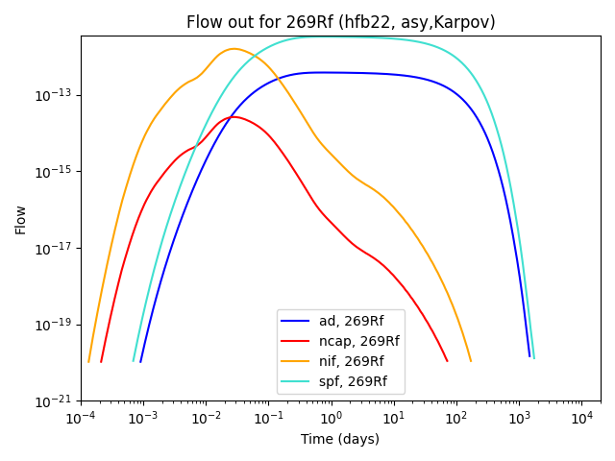
Immediate Investigations
- Vary theoretical reaction rates for highlighted reactions, run through PRISM (Sprouse+ (2020))
Explore effects on heating, thermalization, and produce light curves,
e.g. decay of 269Rf sometimes dominated by α-decay, sometimes by spontaneous fission
20

Slide 26
Questions: Questions?
Thank you!

Slide 27
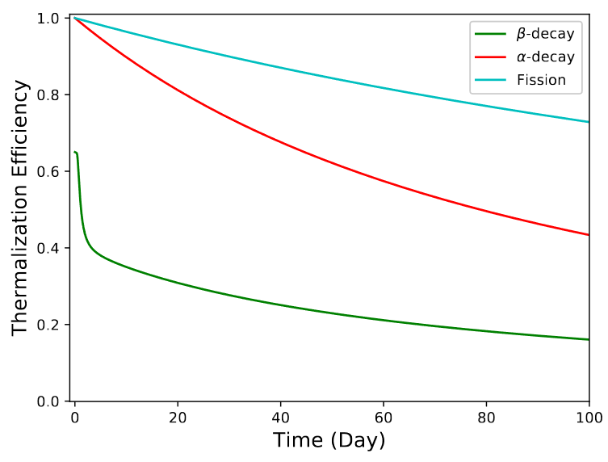
Appendix: Thermalization
The total rate at which energy is thermalized in the ejecta:
$\dot{Q}\left(t\right)=\sum_{i}{f_{i}}(M_{ej},v_{ej},t){\dot{q}}_{i}(t)M_{ej}$,
where f_{i} is assumed to take the form:
$$fi={\left(1+τ\right)}^{−n}$$
τ is scaled to a characteristic timescale t_{i}:
$$t_{th,β}=12.9M_{0.01}^{2/3}v_{0.2}^{−2}ζ^{2/3}$$
$$t_{th,α}=2 t_{th,β}$$
$$t_{th,f}=4 t_{th,β}$$
(n=1)
(n=1.5)
(n=1)
Kasen, Barnes (2019) doi: 10.3847/1538-4357/ab06c2

