Slide 1

ENDF/B-VI Coupled Photon-Electron Data
for Use in Radiation Shielding Applications by Dermott E. Cullen Lawrence Livermore National Laboratory &
Robert E. MacFarlane
Los Alamos National Laboratory presented at the Twelfth Biennial Topical Meeting of the Radiation Protection and Shielding Division, of the American Nuclear Society, to be held April 14-17, 2002 in Santa Fe, New Mexico
This paper will soon be available on-line at http://www.llnl.gov/cullen1

Slide 2
ENDF/B-VI Coupled Photon-Electron Data for Use in Radiation Shielding Applications
For use in Shielding Applications we need
Photon Interaction Data
including direct secondary photons and electrons
Electron Interaction Data
including direct secondary photons and electrons
Data for ALL Photon-Electron Coupling
Fluorescence X-Rays and Auger Electrons
Computer Codes to Use This data
Using Accurate Radiation Transport Methods
Monte Carlo
Data is Useless without Codes
Codes are Useless without Data

Slide 3
ENDF/B-VI Coupled Photon-Electron Data for Use in Radiation Shielding Applications
In order to meet these needs, in the Last Few years Photon and Electron Data Bases have been Greatly Improved
In terms of the Details Included
the Accuracy of the Data
At the Same time there has been an Enormous Increase in Available Inexpensive Computer Power
Today’s Personal Computers = Yesterday’s Super Computers
The Combination allows us to Today Calculate Results
in Greater Detail
to Greater Accuracy
Using Accurate Methods, such as Monte Carlo
Which was not possible just a few years ago

Slide 4
ENDF/B-VI Coupled Photon-Electron Data for Use in Radiation Shielding Applications
We now have Three Different Data bases
the Evaluated Photon Data Library, `97 version (EPDL97)
Interaction of Photons with matter plus direct production of Photons and Electrons
the Evaluated Electron Data Library (EEDL)
Interaction of Electrons with matter plus direct production of Photons and Electrons
the Evaluated Atomic Data Library (EADL)
Relaxation of Ionized Atoms Back to Neutrality
Emission of Photons (fluorescence) and
Electrons (Auger)

Slide 5
ENDF/B-VI Coupled Photon-Electron Data for Use in Radiation Shielding Applications
These Libraries are Designed to be Used in Combination for Detailed Coupled Photon-Electron Radiation Transport Calculations – all contain.
Elemental Data for Z = 1 through 100 (H through Fm)
Over the Energy Range 10 eV to 100 GeV
All Are Consistent,
They all have the Same Subshell Binding Energies
All Contain More Detail than Previously Available
For example, Atomic Subshell Cross Sections
Due to Limited Time I’ll Only Cover EPDL97 in Detail
for EEDL and EADL, See the website
http://www.llnl.gov/cullen1

Slide 6
ENDF/B-VI Coupled Photon-Electron Data for Use in Radiation Shielding Applications
Let’s first look at the improved detailed in our data
Traditional Photon Interaction Data Included
Cross Sections
Coherent and Incoherent Scattering
Photoelectric Absorption
Pair Production
Form Factors
Describe Angular Distribution of Coherent Scattered
Scattering Functions
Describe Angular Distribution of Incoherent Scattered
That’s ALL

Slide 7
ENDF/B-VI Coupled Photon-Electron Data for Use in Radiation Shielding Applications
This is Sufficient to Describe Emission of Primary Photons
Incoherent/Coherent Scatter
Not Sufficient to Describe Secondary Photons
Secondary Fluorescence Photons
Secondary Bremsstrahlung Photons
In-Flight Positron Annihilation
Not Sufficient to Describe Low Energy Scattering
No Anomalous Scattering
Does Not Differentiate Between
Pair Production
Triplet Production

Slide 8
ENDF/B-VI Coupled Photon-Electron Data for Use in Radiation Shielding Applications
EPDL97 includes extra Detail
Photoelectric Subshell Cross Sections
Allows accurate fluorescence, Auger yield
Pair and Triplet Production Cross Sections
Different Kinematics for Each
Anomalous Scattering Factors
ENORMOUS change in low energy coherent scattering
Used with EEDL to define
Bremsstrahlung
Positron In-flight Annihilation
The result is Complete Photon-Electron Coupling

Slide 9
ENDF/B-VI Coupled Photon-Electron Data for Use in Radiation Shielding Applications
Figure 1 illustrates the Traditional
Photon Cross Sections for Lead
Basically just four cross sections
Coherent Scattering
Incoherent Scattering
Photoelectric absorption
Pair Production

Slide 10
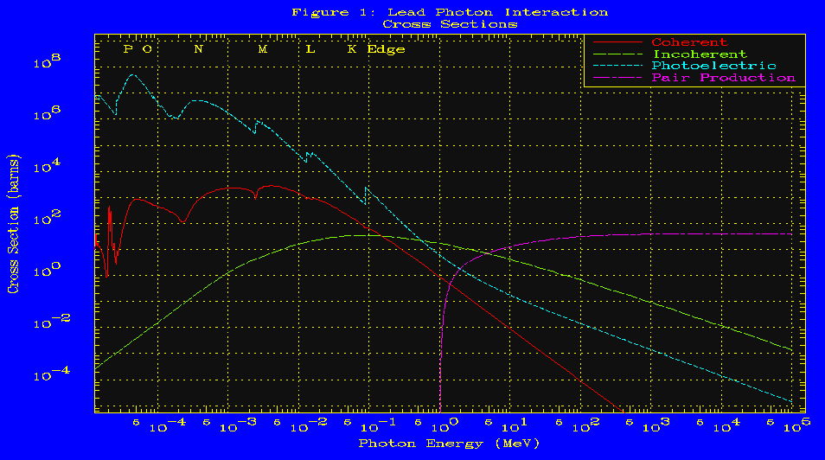
ENDF/B-VI Coupled Photon-Electron Data for Use in Radiation Shielding Applications
photoelectric
4 basic lead cross sections
coherent
pair
incoherent
10 eV
100 GeV

Slide 11
ENDF/B-VI Coupled Photon-Electron Data for Use in Radiation Shielding Applications
In order to illustrate the increase in Detail in our Current Photon Data Bases (EPDL97) Figure 2 illustrates the Lead Photoelectric Subshell Cross Sections
Compared to the four Traditional Cross Sections
Where No Further detail is available
Here we have Cross Sections for each of the 24 Subshells
Each subshell has its own Binding energy
and its own Photon and Electron Emission Spectra
the Spectra are defined by Our EADL Data Base

Slide 12
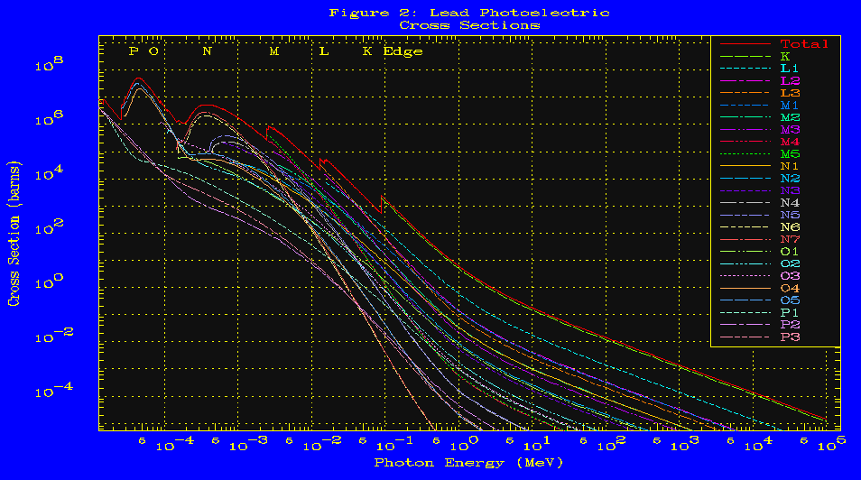
ENDF/B-VI Coupled Photon-Electron Data for Use in Radiation Shielding Applications
24 photoionization
subshell cross sections
10 eV
100 GeV

Slide 13
ENDF/B-VI Coupled Photon-Electron Data for Use in Radiation Shielding Applications
Figure 3 illustrates Similar Detail for the Lead Electron Ionization Subshell Cross Sections - from EEDL
Compared to Traditional Electron transport
Where only one Average Ionization is Defined
Here we have Cross Sections for each of the 24 Subshells
Each Contributes differently to Electron Ionization
Each subshell has its own Binding energy
and its own Photon and Electron Emission Spectra
the Spectra are defined by Our EADL Data Base

Slide 14
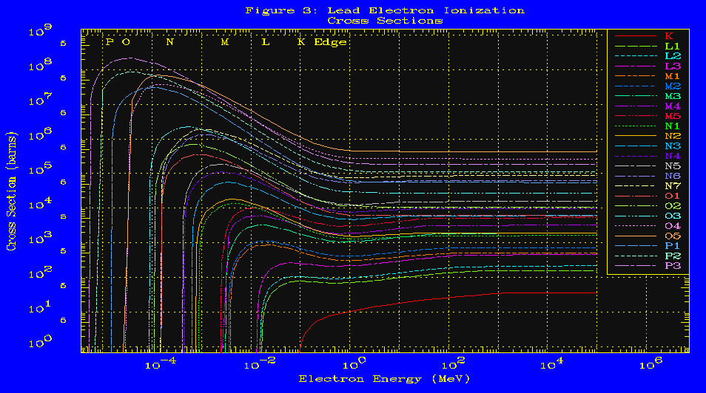
ENDF/B-VI Coupled Photon-Electron Data for Use in Radiation Shielding Applications
24 electroionization
subshell cross sections
10 eV
100 GeV

Slide 15
ENDF/B-VI Coupled Photon-Electron Data for Use in Radiation Shielding Applications
Question: Do we really need all of this extra detail?
Are Photoelectric Subshell Cross Sections Really Needed?
Traditionally it was Assumed that each photoelectric absorption resulted in all of the energy of the incident photon being deposited at the point of the absorption.
In lead a 88.3 keV photon would deposit 88.3 keV of energy
Based on our EADL data Figure 4 illustrates that when a photon undergoes photoelectric absorption just above the lead K-Edge at 88.3 keV, 77.6 keV (87.9 % of its energy) is Re-emitted as Fluorescence X-Rays and only 10.7 keV is deposited.
88.3 keV versus 10.7 keV deposited
The traditional result is 850 % too HIGH

Slide 16
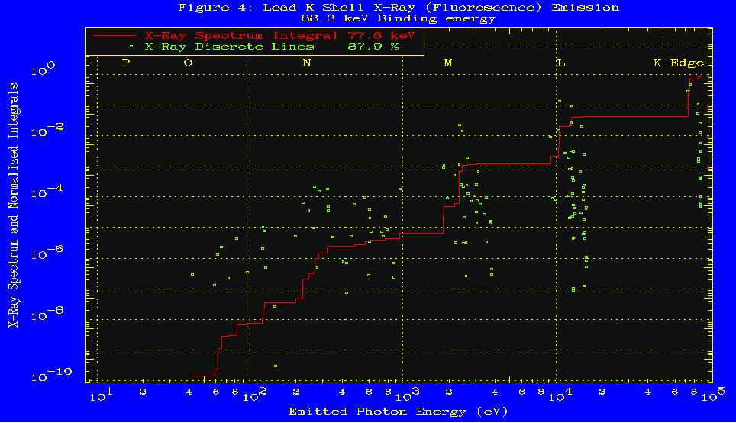
ENDF/B-VI Coupled Photon-Electron Data for Use in Radiation Shielding Applications
Each Green point represents
a discrete x-ray emission line
Discrete lines and
Integral of the lines
The Red curve represents
the integral over the x-ray
emission lines
10 eV
100 keV

Slide 17
ENDF/B-VI Coupled Photon-Electron Data for Use in Radiation Shielding Applications
Question: Is Anomalous Scattering Important?
Returning to Figure 1, note that near 10 eV the Lead Coherent Scattering Cross section, which includes the effect of Anomalous Scattering, is About 10 Barns
In Contrast the Traditional Coherent Scattering Cross section is About 4,480 barns
4,480 barns versus 10 barns
Traditional value is a Factor of 448 too large

Slide 18
ENDF/B-VI Coupled Photon-Electron Data for Use in Radiation Shielding Applications
1) Coherent near 10 eV
is really about 10 barns
Coherent
2) Traditional value
Is 4,480 barns
10 eV
100 GeV

Slide 19
ENDF/B-VI Coupled Photon-Electron Data for Use in Radiation Shielding Applications
In the limited Time Available I have Mostly Discussed EPDL97
EPDL97 is Designed to be Used with EEDL & EADL to Perform Complete Coupled Photon-Electron Radiation Transport Calculations
the Evaluated Photon Data Library, ‘97 version (EPDL97)
Interaction of Photons with matter plus direct production of Photons and Electrons
the Evaluated Electron Data Library (EEDL)
Interaction of Electrons with matter plus direct production of Photons and Electrons
the Evaluated Atomic Data Library (EADL)
Relaxation of Ionized Atoms Back to Neutrality
Emission of Photons (fluorescence) and Electrons (Auger)

Slide 20
ENDF/B-VI Coupled Photon-Electron Data for Use in Radiation Shielding Applications
Recently we’ve improved our availability to accurately model photon-electron transport
But as yet we are NOT YET where we would like to be
There are Still Improvements and Extensions to make
For complete Details see the EPDL97 Documentation
On-line at http://www.llnl.gov/cullen1
Here I’ll Only Mention Photonuclear
Still not included in EPDL97 – but data is now available
Potentially Important in Many Applications
Positive Effect: Strong, Localized Energy Deposit Tumors
Negative Effect: Activates your accelerator

Slide 21
ENDF/B-VI Coupled Photon-Electron Data for Use in Radiation Shielding Applications
These Data Bases are useless without computer codes
That prepare them for use in applications (NJOY)
And use them in applications (TART)
The TART Monte Carlo code has used these data bases
for a number of years
So they have a track record that shows improved results
Only recently data bases were adopted within ENDF/B-VI
Now NJOY is being updated
Soon NJOY results will be generally available
For use in MCNP & Sn codes

Slide 22
ENDF/B-VI Coupled Photon-Electron Data for Use in Radiation Shielding Applications
In This paper I’ve Introduced our Data Bases
Particularly our photon Data Base EPDL97
EPDL97 is Designed to Meet the Needs of
Tradition Data users with Less Details
No Additional photons: Fluorescence or Bremsstrahlung
As well as Those Users who want to Use More Details
by Simply including Fluorescence X-Rays
or also Bremsstrahlung without Electron Transport
or Complete Coupled Photon-Electron transport
You are free to use as little or as much detail as you want

Slide 23
ENDF/B-VI Coupled Photon-Electron Data for Use in Radiation Shielding Applications
Lastly I’ll Mention that
All three Data Bases
Are now FREELY!! Available - Internationally
See the website http://www.llnl.gov/cullen1
Where you can obtain copies of documentation
and find out how to obtain Data Bases
through International Code centers
And now available on-line
I’ll again stress that these data bases are
useless without codes to prepare and use them
Soon NJOY results will be available for use

Slide 24

Da-da, da-da, dat’s All Folks

